Slide 1
ISP152 – Topic 3: Operations and Human security
3.1 Introduction
3.2 Protecting the organisation against vulnerabilities and risks
3.3 Recognising and addressing social engineering attacks
3.4 Identifying physical threats and appropriate security controls

Slide 2
Module Outcomes
Demonstrate an understanding of the Open Systems Interconnection (OSI) model and common network architectures.
Identify the key hardware and software components found in computer networks.
Participate in the implementation of the basic principles that underpin the protection of information assets (identification, authentication, etc).
Identify the different stages of the operations security process, and the activities that occur within each stage.
Identify common threats affecting information security at the human level, the physical level, the network level and the application level; and outline preventative measures that can be used to eliminate or manage these threats.

Slide 3
(3.1) Introduction
In this topic, you will gain knowledge in the following areas:
3.2 Protecting the organisation against vulnerabilities and risks
3.3 Recognising and addressing social engineering attacks
3.4 Identifying physical threats and appropriate security controls

Slide 4
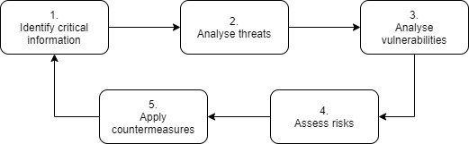
(3.1) Introduction
Organisational data is constantly exposed to threats originating from a variety of sources, ranging from hackers, viruses, and denial of service attacks to the use of weak passwords by employees, deliberate data manipulation, or the theft of organisational data or equipment.
The operations security process:

Slide 5
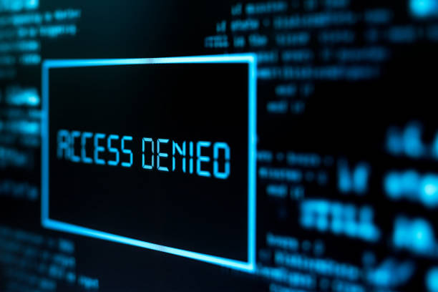
(3.1) Introduction
Employees can unintentionally help intruders gain unauthorised access to systems.
Criminals may pose as senior managers to obtain confidential information.
Weak passwords can make systems vulnerable to hackers.
Employees might be manipulated into copying and selling confidential data.

Slide 6

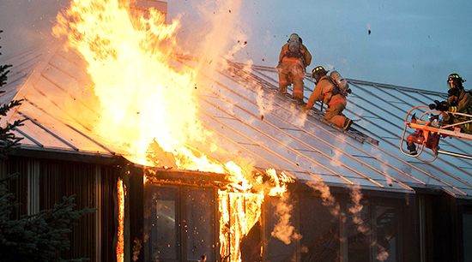
(3.1) Introduction
These risks show the importance of providing security training to staff.
Physical threats include intruders, fire, and water damage.
In such cases, protecting human life (e.g. evacuation procedures) is more critical than protecting data or equipment.

Slide 7

(3.2) Protecting the organisation against vulnerabilities and risks
3.2.1 The operations security process
The operations security process comprises five stages:
Identify information that needs to be protected.
Identify potential threats to that information.
Analyse existing system vulnerabilities.
Assess the potential impact of identified threats.
Implement countermeasures to prevent or mitigate the impact of threats.

Slide 8
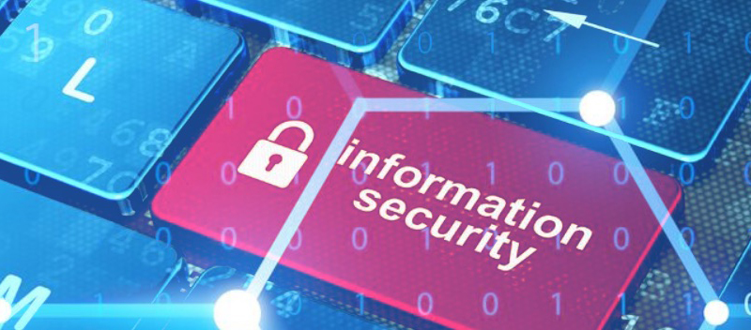
(3.2) Protecting the organisation against vulnerabilities and risks
Security policies must be tailored to the value and risk of the information.
First, assess which information assets are most valuable or damaging if exposed.
Consider how outsiders could exploit this information.
Choose countermeasures to avoid or reduce risks.
Information security is ongoing — systems must be regularly monitored and improved.

Slide 9
(3.2) Protecting the organisation against vulnerabilities and risks
Activity
Watch the following video:
Title: Operations Security.
Link: https://www.youtube.com/watch?v=c8s44iRuW6o
Time allocation: 03:00

Slide 10
(3.2) Protecting the organisation against vulnerabilities and risks
3.2.2 The ‘laws’ of operations security
Three ‘laws’ of operations security are discussed in a paper by Haase (1992). Haase explains how these laws operate by using the analogy of a set of tools that can be used to navigate a maze that has a dragon at its centre. He summarises the three laws of OPSEC as follows:
If you don't know the threat, how do you know what to protect?
If you don't know what to protect, how do you know you are protecting it?
If you are not protecting it (the information), … the dragon wins!

Slide 11
(3.2) Protecting the organisation against vulnerabilities and risks
Activity
Read the contents of the text box entitled “Operations Security and Social Media” on pages 100-101 in the prescribed textbook by Andress (2019). Then make notes outlining how social media users may unintentionally expose themselves to unwanted risks and suggest steps they can take to reduce their exposure to these risks.
Time allocation: 15 minutes

Slide 12
(3.2) Protecting the organisation against vulnerabilities and risks
Operations security principles date back to the 6th century BCE.
Sun Tzu stressed knowing the enemy and protecting one’s own info.
George Washington noted that small bits of info can be valuable when combined.
During the Vietnam War, concerns about leaked info led to the first ops security group.
Today, many large organisations use these principles for decision-making and business protection.

Slide 13

(3.3) Recognising and addressing social engineering attacks
3.3.1 Sources of information for social engineering attacks
Not all threats can be solved with technology alone.
Examples: weak or exposed passwords, unlocked computers, impersonation of managers.
These human risks are best managed through policies and staff training.
Social engineering targets people using persuasive tactics.
Social media helps attackers find vulnerable or new employees.
Departing staff may also be at risk of manipulation.

Slide 14
(3.3) Recognising and addressing social engineering attacks
Activity
Watch the following video:
Title: What is Social Engineering?
Link: https://www.youtube.com/watch?v=Vo1urF6S4u0
Time allocation: 02:02

Slide 15
(3.3) Recognising and addressing social engineering attacks
Social engineering attacks rely on HUMINT and OSINT.
HUMINT: gathered by observing and speaking to people about their roles and routines.
OSINT: taken from social media, job ads, public records, and company websites.
Info-gathering tools and methods are discussed in Andress (2019: 109–113).

Slide 16

(3.3) Recognising and addressing social engineering attacks
3.3.2 Types of social engineering attacks
Pretexting: Attacker poses as a trusted insider with a believable story to trick employees.
Phishing:
Basic: Phone calls to gather info.
Advanced: Emails/texts link to fake sites that install malware.
Spear phishing: Targets specific people, appears to come from a known contact.
Tailgating: Attacker follows a real employee into a secure area, often using excuses like forgetting their access card.

Slide 17
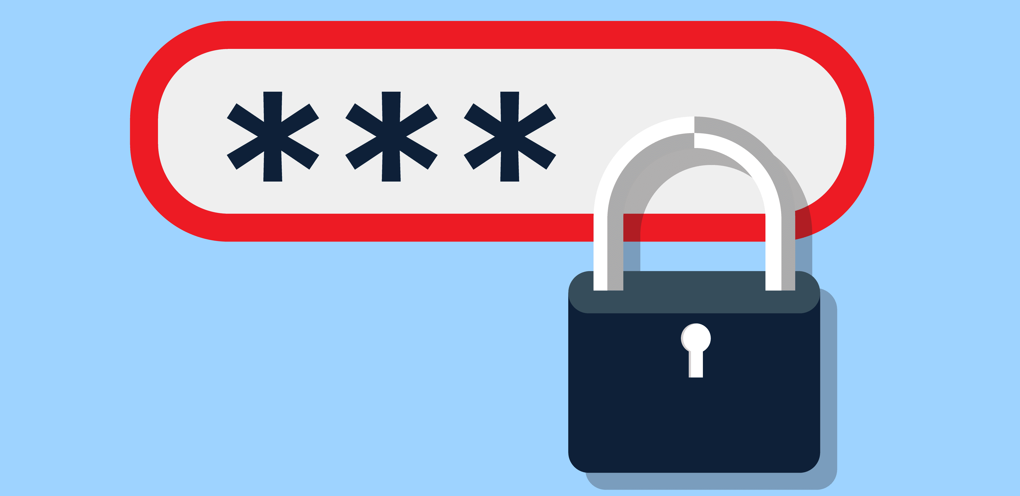
(3.3) Recognising and addressing social engineering attacks
3.3.3 Developing employee security awareness
Regular security training should be provided, supported by tools like online quizzes.
Key topics:
Safe password practices
Verifying suspicious calls/emails
Blocking unauthorised network access
Risks of using public networks

Slide 18

(3.3) Recognising and addressing social engineering attacks
3.3.3 Developing employee security awareness
Warn about:
Unknown attachments and dodgy URLs
Pirated software and unofficial apps
Policies should cover:
Personal device use at work
Taking company devices home
Storage/disposal of sensitive physical media
Use emails or posters to raise ongoing security awareness.

Slide 19
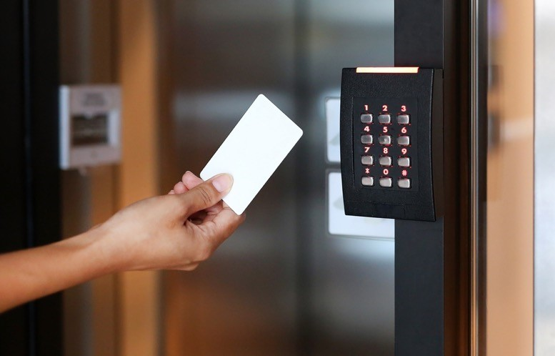
(3.4) Identifying physical threats and appropriate security controls
3.4.1 Identifying physical threats and security controls
Physical security protects people, equipment, and data facilities.
Identify threats (e.g. heat, liquids, animals, projectiles, etc.) to apply proper controls.
Types of controls:
Deterrent: Discourage intrusions (e.g. signs, lighting).
Detective: Monitor/report events (e.g. alarms, sensors).
Preventive: Block access (e.g. locks, fences, guard dogs).

Slide 20
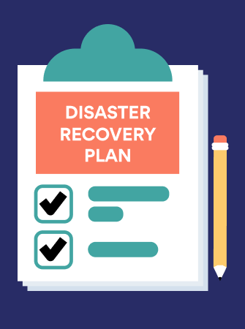
(3.4) Identifying physical threats and appropriate security controls
Security level depends on the value of people and assets at the location.
Business continuity ensures operations during disruptions.
Disaster recovery outlines response steps after a disaster.

Slide 21
(3.4) Identifying physical threats and appropriate security controls
Activity
Watch the following video:
Title: What is Business Continuity Planning (BCP)?
Link: https://www.youtube.com/watch?v=ZetTrqWFE_w
Time allocation: 02:30

Slide 22
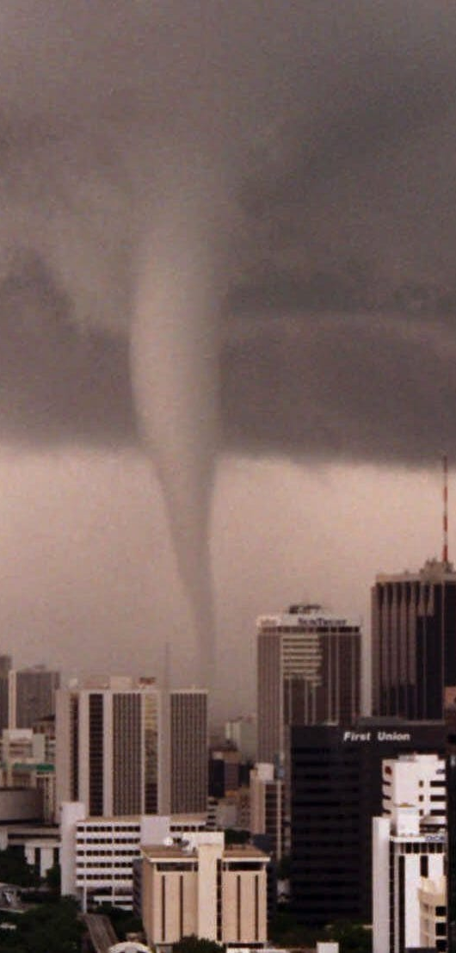
(3.4) Identifying physical threats and appropriate security controls
3.4.2 Protecting people
Humans face physical threats: extreme weather, toxins, organisms (e.g. COVID-19), radiation, structural collapse, and intruders.
Intruders may use social engineering or physical force.

Slide 23

(3.4) Identifying physical threats and appropriate security controls
Evacuation plans must be current and clearly communicated.
Know gathering points, safest routes, and alternatives.
One person ensures evacuation; another ensures everyone reaches the gathering point.
Act immediately when alarms sound—no time for shutting down or locking up.
Administrative controls: background checks, drug tests, and formal policies/regulations to protect staff.

Slide 24
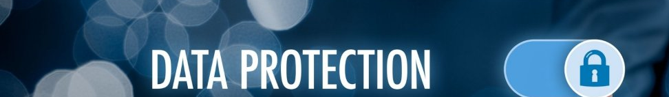
(3.4) Identifying physical threats and appropriate security controls
3.4.3 Protecting data and equipment
Encryption protects data, but not against physical threats like heat, humidity, or impact.
Magnetic media can be corrupted by magnetic fields or jolts.
Optical discs can be damaged by scratches.
RAID allows data recovery if a disk fails; data replication offers even greater safety.
Confidential data must be destroyed before disposing of a device.

Slide 25
(3.4) Identifying physical threats and appropriate security controls
Server rooms must be protected from heat, humidity, insects, and power issues.
UPS protects against power loss and voltage spikes.
Earthquakes and fires should be factored into facility site selection.
Physical security: use fences, guards, locks, cameras, and access control.
Maintain proper environmental conditions and use generators in large facilities.

Slide 26
(3.4) Identifying physical threats and appropriate security controls
Activity
Create a diagram such as a mind map that illustrates the relationship between the physical threats that are identified in Chapter 9 of the prescribed textbook by Andress (2019), and the security controls that can be used to address or mitigate those threats.
Time allocation: 15 minutes

